Slide 1


Social Buzz

Slide 2


Today's Agenda
Project Recap
Problem
The Analytics Team
Process
Insights
Summary

Slide 3

Social Buzz, a booming social media platform, is experiencing explosive growth. Accenture steps in to assist them with a focused 3-month plan:
Big Data Audit: Accenture will analyze and optimize Social Buzz data handling for their massive user base.
IPO Roadmap: Accenture's experts will guide Social Buzz through the complexities of a smooth Initial Public Offering.
Content Insights: Leveraging data analysis expertise, Accenture will uncover top content categories to inform future platform strategies for Social Buzz.
Project Recap

Slide 4


Problem
Over 100,000 pieces of content are posted daily.
36,500,000 pieces of content per year
Difficult to handle such Big Data
Identify top 5 catogories with the largest aggregate popularity

Slide 5



Harish Malviya
Data Analyst
The Analytics Team
Marcus Rompton
Senior Principle
Andrew Fleming
Chief Technical Architech

Slide 6
Process
1
Data Understanding
2
Data Cleaning
3
Data Modelling
4
Data Analysis
5
Uncover Insights

Slide 7

Insights
Higest Score
CATEGORY
‘ANIMAL’
Unique
CATEGORIES
Most Posts
MONTH
16
74965
MAY

Slide 8
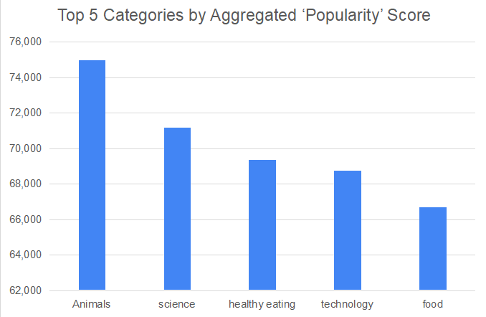

Slide 9
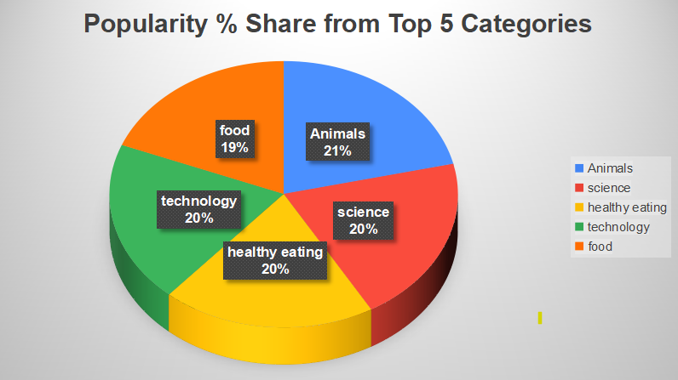

Slide 10

ANALYSIS
Animals and science are two most popular content categories. this shows that people enjoy ‘real life’ and ‘factual’ content the most, So I would recommend that you keep creating more content relating to these two categories.
INSIGHT
Food is a common theme with the top 5 categories with ‘Healthy Eating’ ranking as one of the highest, This may give an indication to the audience within your user base, You could use this insight to create a campaign and work healthy eating brands to boost user engagement
NEXT STEPS
It should come as no suprise that technological content is among the top categories given the advancement of technological material. Working with some of the biggest digital companies in the world is something I would suggest doing because it would undoubtedly increase user engagement.
Summary

Slide 11

Thank you!
ANY QUESTIONS?

